Slide 1

Version Control System Represented by: Navaneeth Nair Prasad Magdum Rutuja Mali Saniya Pathan
BHARATI VIDYAPEETH’S COLLEGE OF ENGINEERING, KOLHAPUR Department of CSE (Artificial Intelligence & Machine Learning) YEAR:
2024-25

Slide 2
INDEX
Introduction
Project Objectives
Key features
Implementation
Results
Conclusion

Slide 3
Introduction
A Version Control System (VCS) is a critical tool for software development, enabling developers to track, manage, and collaborate on code efficiently. This project aims to build a web-based VCS using React.js for the front end and Django for the back end, providing a user-friendly and scalable solution for version control. The system will allow users to: Create and manage repositories for storing their projects. Upload, modify, and delete files while maintaining a version history. Track changes and commit histories, enabling easy rollback and recovery. Collaborate with teams, supporting multi-user access and role-based permissions. Resolve merge conflicts through an interactive interface. The frontend will offer an intuitive dashboard where users can interact with repositories, view commit histories, compare file versions, and handle merge requests efficiently. The backend will be responsible for user authentication, repository and file version management, handling commits, and API communication to ensure smooth operations and data integrity.

Slide 4
Project Objectives
Efficient Source Code Management - To systematically track, manage, and store changes made to the project codebase throughout the development lifecycle.
Facilitate Team Collaboration- To enable multiple team members to work on the project simultaneously, without conflict or overwriting each other’s code.
Maintain Version History- To keep a complete history of all changes, allowing developers to review, revert, or compare previous versions when necessary.
Enable Safe Experimentation - To allow developers to create separate branches for testing new features or making improvements without affecting the main codebase.
Simplify Code Integration and Review- To streamline the process of merging code changes and reviewing contributions through pull requests and code discussions.
Ensure Code Backup and Recovery- To use GitHub as a cloud-based backup system, ensuring that the project files are safe and accessible from anywhere

Slide 5
Problem Statement
This project aims to develop a web-based Version Control System (VCS) using React.js for the frontend and Django for the backend. The system will provide users with a platform to manage repositories, track file modifications, collaborate with teams, and resolve merge conflicts efficiently.

Slide 6
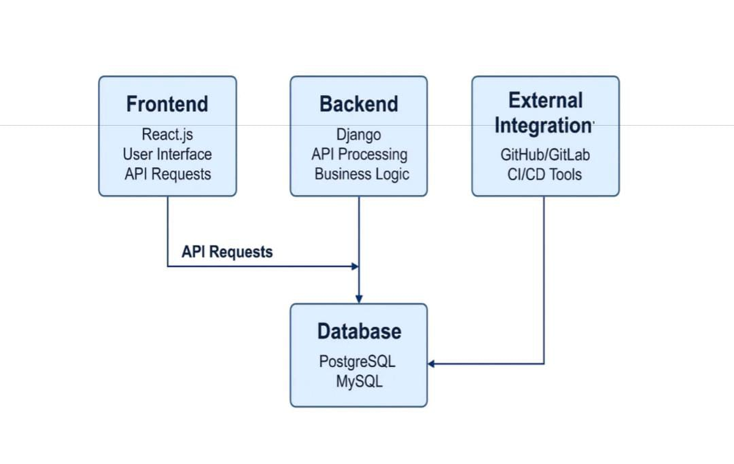
System Architecture

Slide 7
Key Features
1.Distributed Version Control - GitHub uses Git, a distributed version control system, allowing every contributor to have a full copy of the repository with complete history and changes.
2.Remote Repository Management- GitHub serves as the origin or remote repository where all changes from local systems are pushed, enabling centralized collaboration and access.
3.Branching and Merging- Developers can create branches to work on features or fixes independently. GitHub makes it easy to merge these changes back into the main branch after review.
4.Pull Requests -GitHub allows contributors to propose changes through pull requests, which support code review, discussion, and testing before merging.
5.Commit History and Change Tracking-Every code change is logged with a timestamp, author information, and a descriptive message, ensuring full traceability.

Slide 8
Implementation of Version Control
The version control system for this project was implemented using Git and GitHub. Git was installed and configured on local development machines, and a new repository was initialized. A remote repository was created on GitHub and linked to the local repository. Project files were added, committed with meaningful messages, and pushed to the remote repository. Branches were used to develop features independently, and pull requests facilitated code review and merging. Regular pulls were performed to synchronize the codebase across team members. Merge conflicts, if any, were resolved manually to ensure a stable and up-to-date main branch throughout the development cycle

Slide 9
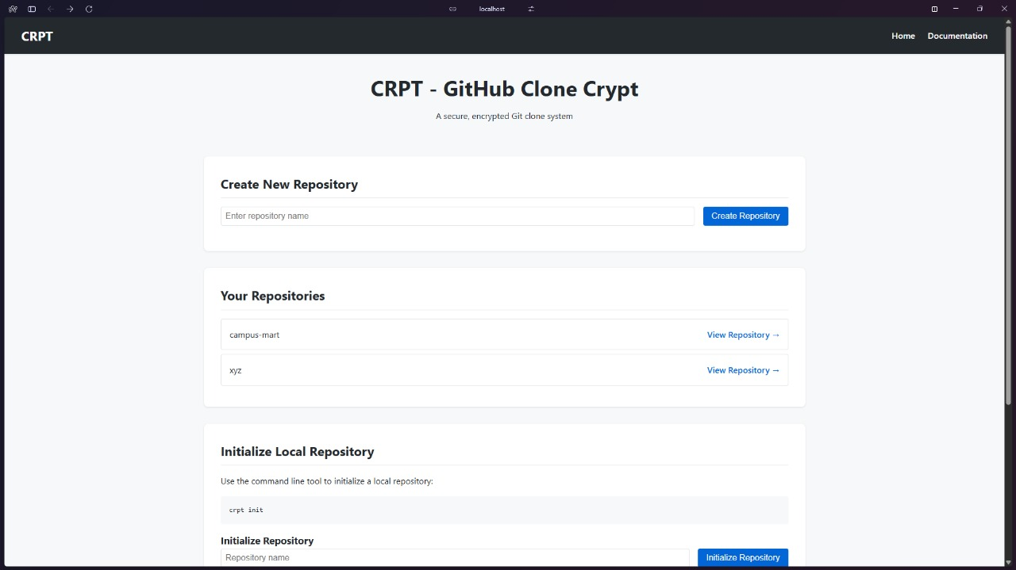

Slide 10
Conclusion
The development of a web-based Version Control System (VCS) using React.js and Django marks a significant step toward simplifying and enhancing the way developers manage code. By offering an intuitive user interface, secure backend logic, and essential version control features like commits, branching, file history, and role-based collaboration, this system bridges the gap between functionality and user-friendliness. This project successfully addresses several challenges posed by traditional VCS tools, such as complexity for beginners, lack of customization, and dependency on external services. The interactive interface for managing repositories, visual commit tracking, and built-in merge conflict resolution tools provide an accessible and efficient experience, especially for teams and educational environments. The system’s modular architecture, RESTful API integration, and potential for external service connectivity (like GitHub/GitLab) ensure scalability and adaptability to realworld development needs. The Agile development approach facilitated incremental progress, testing, and refinement based on continuous feedback. In conclusion, the proposed VCS platform is not only a powerful alternative to existing tools but also a foundation for further innovation in version control solutions tailored to specific organizational or project-based requirements.

